Slide 1
LOGIN SESSION
LABTI UNIVERSITAS GUNADARMA
2016

Slide 2


Autoload.php

Slide 3


Route.php
Config.php

Slide 4
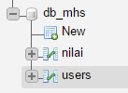


Slide 5

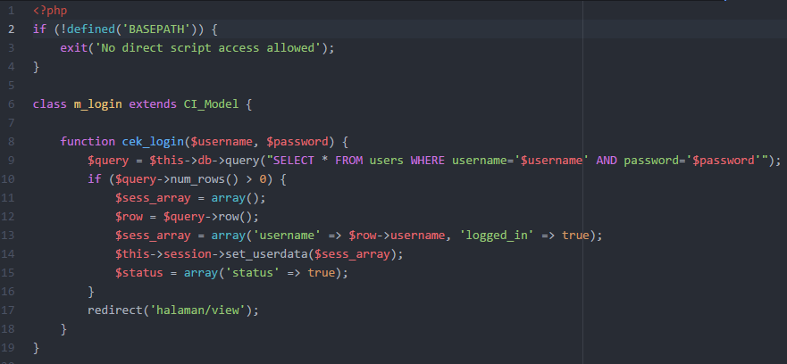
m_login.php

Slide 6

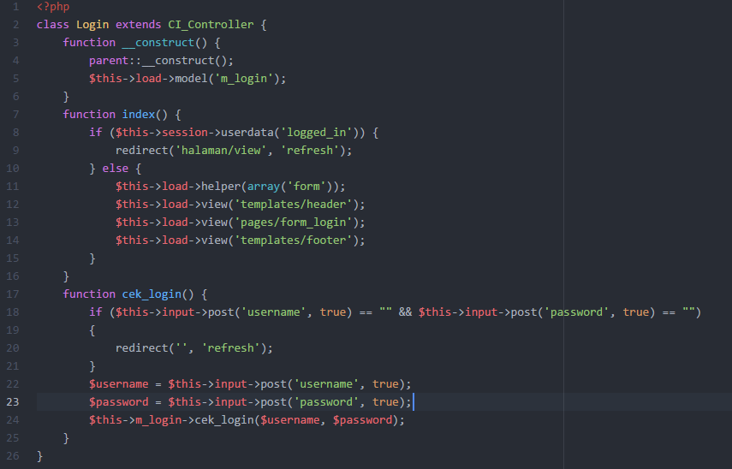
login.php

Slide 7
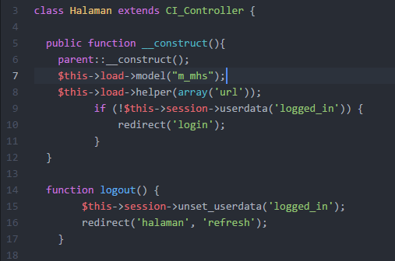
halaman.php

Slide 8
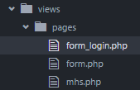
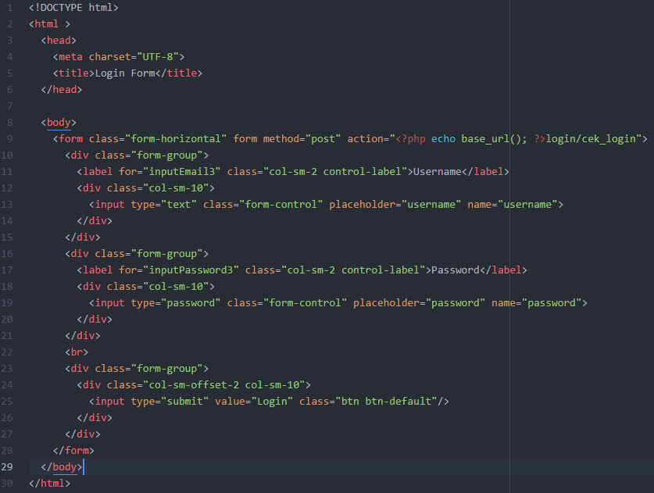
form_login.php

Slide 9

mhs.php

Slide 10


Slide 11
